Slide 1

Chapter 4
Decrease-and-Conquer
Copyright © 2007 Pearson Addison-Wesley. All rights reserved.

Slide 2
Decrease-and-Conquer
The decrease-and-conquer technique is based on exploiting the relationship between a solution to a given instance of a problem and a solution to its smaller instance. Once such a relationship is established, it can be exploited either top down or bottom up.
There are three major variations of decrease-and-conquer.
Decrease by a constant
Decrease by a constant factor
Variable size decrease.

Slide 3
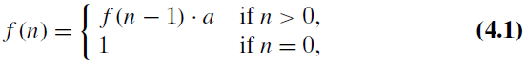
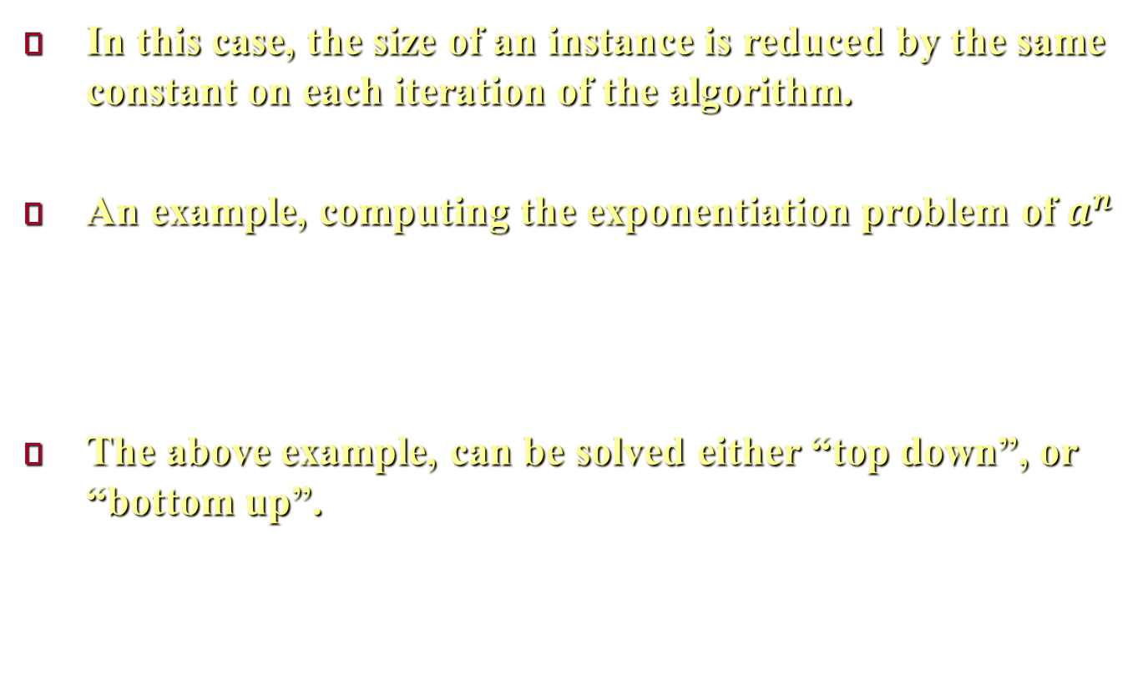
The decrease-by-a-constant variation
In this case, the size of an instance is reduced by the same constant on each iteration of the algorithm.
An example, computing the exponentiation problem of $a^{n}$
The above example, can be solved either “top down”, or “bottom up”.
Notes:
In this case, the size of an instance is reduced by the same constant on each iteration of the algorithm. Typically, this constant is equal to one, although other constant size reductions do happen occasionally.
For example, the exponentiation problem of computing $a^{n}$ where $a≠0$, and $n$ is a nonnegative integer. The relationship between a solution to an instance of size $n$ and an instance of size $n − 1$ is obtained by the obvious formula $a^{n}=a^{n−1}.a$. So the function $f\left(n\right)=a^{n}$ can be computed either “top down” by using its recursive definition $f\left(n\right)=\left\{\begin{matrix}\begin{matrix}f\left(n−1\right).a, & if n>0,\end{matrix} \\ \begin{matrix}1, & if n=0\end{matrix} \end{matrix}\right.$, or “bottom up” by multiplying $1$ by a $n$ times.

Slide 4
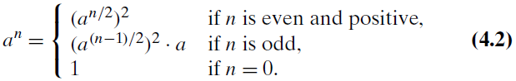
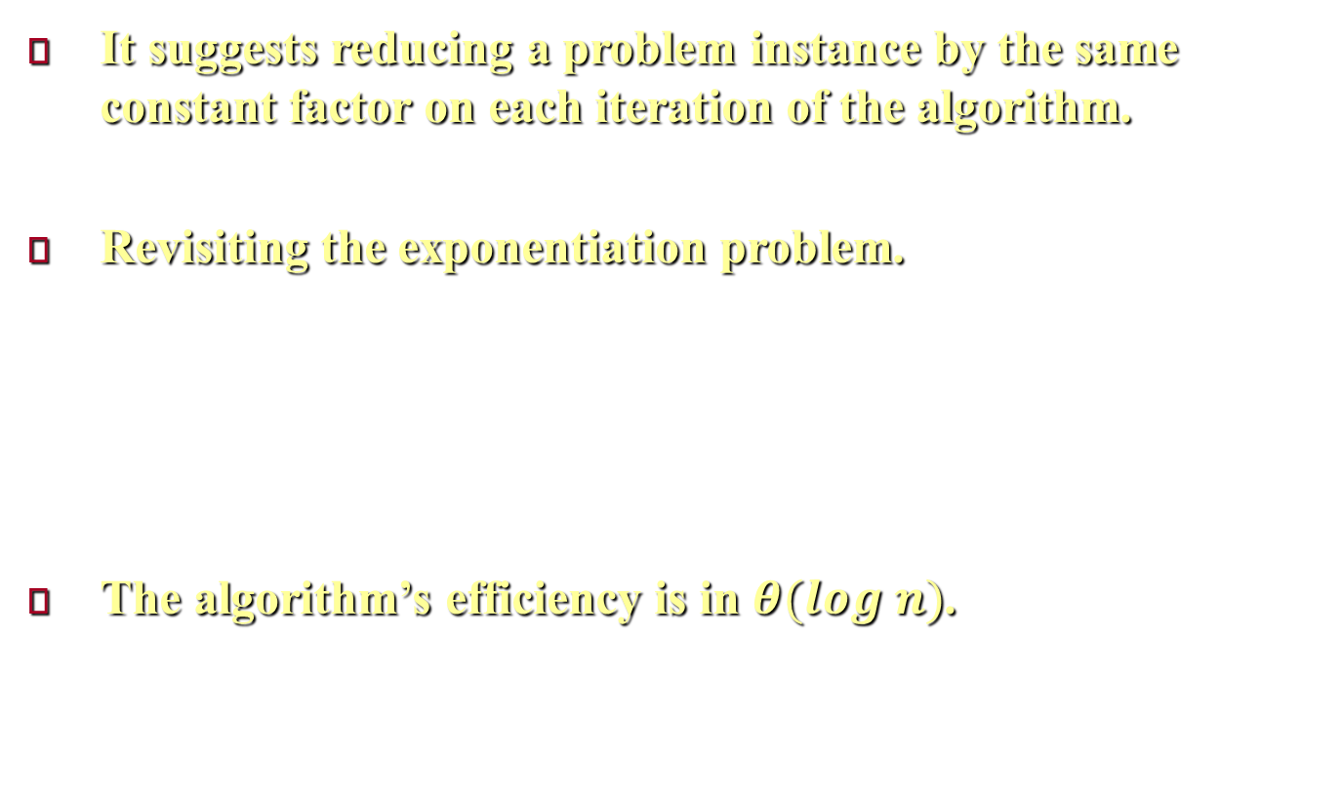
The decrease-by-a-constant factor variation
It suggests reducing a problem instance by the same constant factor on each iteration of the algorithm.
Revisiting the exponentiation problem.
The algorithm’s efficiency is in $θ(log n)$.
Notes:
The decrease-by-a-constant-factor technique suggests reducing a problem instance by the same constant factor on each iteration of the algorithm. In most applications, this constant factor is equal to two.
For example, let us revisit the exponentiation problem.
$a^{n}=\left\{\begin{matrix}{\left(a^{n/2}\right)}^{2}\begin{matrix}, & if n is even and positive,\end{matrix} \\ {\left(a^{(n−1)/2}\right)}^{2}\begin{matrix}.a, & if n is odd,\end{matrix} \\ 1, if n=0\end{matrix}\right.$
If we compute $a^{n}$ recursively according to the above formula and measure the algorithm’s efficiency by the number of multiplications, we should expect the algorithm to be in $θ(log n)$ because, on each iteration, the size is reduced by about a half at the expense of one or two multiplications.

Slide 5
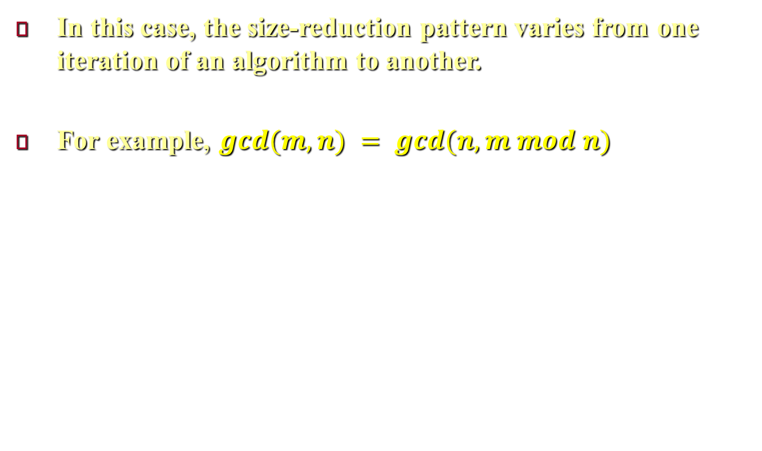
The variable-size-decrease variation
In this case, the size-reduction pattern varies from one iteration of an algorithm to another.
For example, $gcd⁡(m, n) = gcd⁡(n, m mod n)$
Notes:
In this case, the size-reduction pattern varies from one iteration of an algorithm to another. Euclid’s algorithm for computing the greatest common divisor provides a good example of such a situation. Since the algorithm is based on the formula $gcd⁡(m, n) = gcd⁡(n, m mod n)$, Though the value of the second argument is always smaller on the right-hand side than on the left-hand side, it decreases neither by a constant nor by a constant factor.

Slide 6
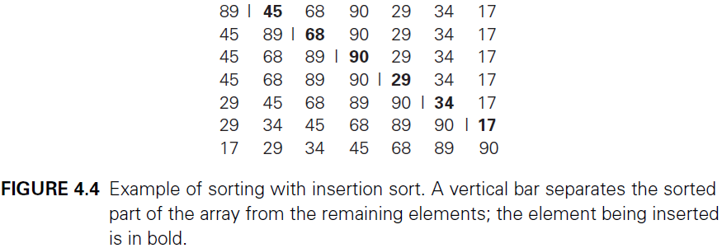
Insertion Sort
Follows the decrease-by-one technique.
Assumes a smaller sorted list then insert a new element in right position in this list.
Can be implemented bottom up as shown below.
Notes:
Insertion sort Follows the decrease-by-one technique, where we assume that the smaller problem of sorting the array $A[0..n − 2]$ has already been solved to give us a sorted array of size $n − 1$ then we find an appropriate position for $A[n − 1]$ among the sorted elements and insert it there. This is usually done by scanning the sorted subarray from right to left until the first element smaller than or equal to $A[n − 1]$ is encountered to insert $A[n − 1]$ right after that element.
We implement this algorithm bottom up, i.e., iteratively. As shown in Figure 4.4, starting with $A[1]$ and ending with $A[n − 1]$.

Slide 7
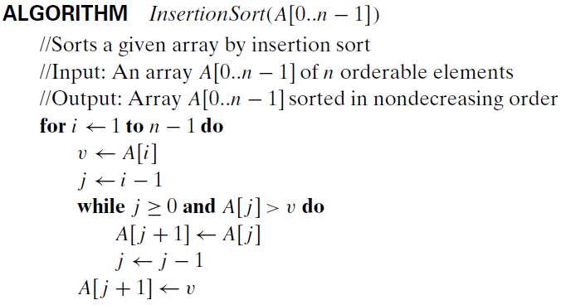
Insertion Sort
Notes:
Above is the pseudocode of this algorithm.

Slide 8
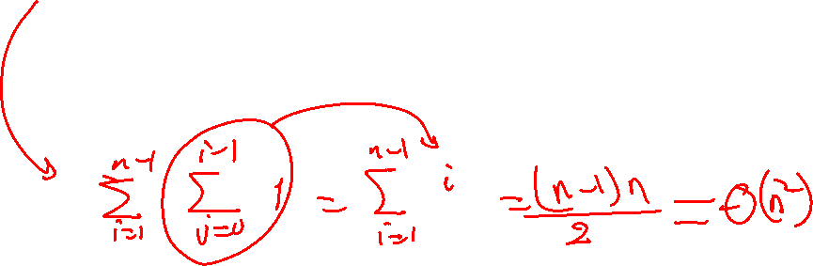
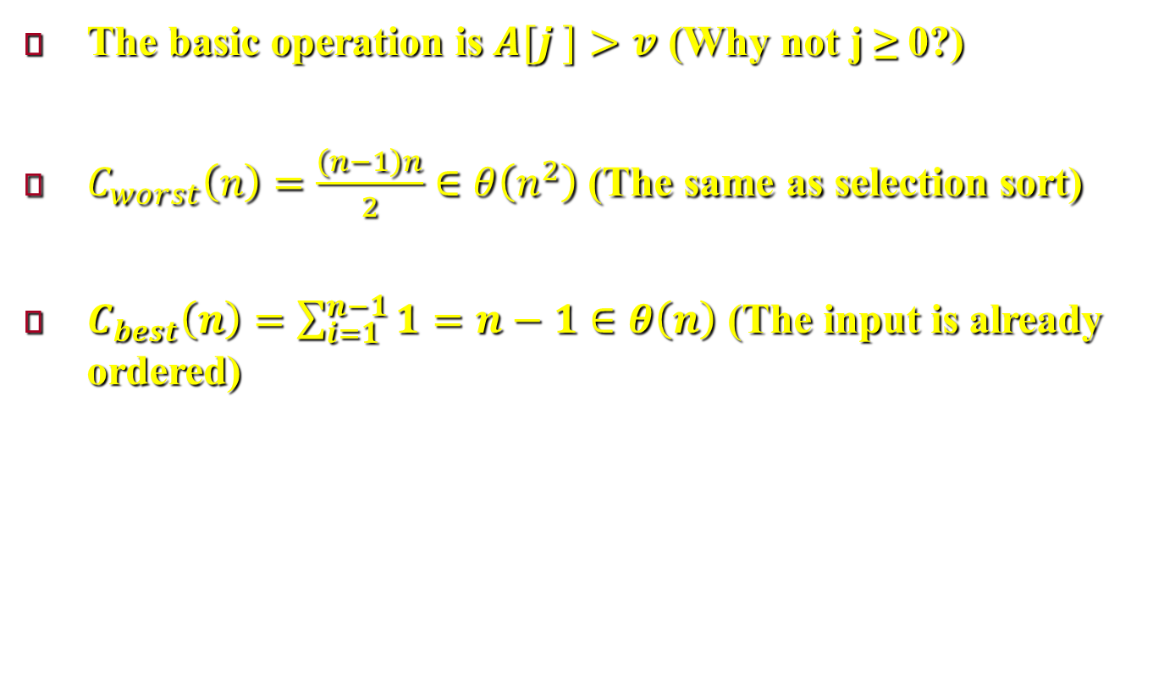
Insertion Sort
The basic operation is $A[j ]>v$ (Why not j ≥ 0?)
$C_{worst}\left(n\right)=\frac{\left(n−1\right)n}{2}∈θ\left(n^{2}\right)$ (The same as selection sort)
$C_{best}\left(n\right)=\sum_{i=1}^{n−1}{1}=n−1∈θ\left(n\right)$ (The input is already ordered)
Notes:
The basic operation of the algorithm is the key comparison $A[j ]>v$. (Why not j ≥ 0? Because it is almost certainly faster than the former in an actual computer implementation. Moreover, it is not germane to the algorithm: a better implementation with a sentinel—see Problem 8 in this section’s exercises—eliminates it altogether, we can add an element in the beginning of the of the array and put this element greater than or equal the first element in the list to be sorted. In this case the array will be of size $n+1$, and $A[0]=A[1]$).
The number of key comparisons in this algorithm obviously depends on the nature of the input. In the worst case, $A[j ]> v$ is executed the largest number of times, i.e., for every $j = i − 1, . . . , 0$. Since $v = A[i]$, it happens if and only if $A[j ]>A[i]$ for $j = i − 1, . . . , 0$. Thus, for the worst-case input, we get $A[0]>A[1]$ (for i = 1), $A[1]>A[2]$ (for i = 2), . . . , $A[n − 2]>A[n − 1]$ (for $i = n − 1$). In other words, the worst-case input is an array of strictly decreasing values. The number of key comparisons for such an input is $C_{worst}\left(n\right)=\sum_{i=1}^{n−1}{\sum_{j=0}^{i−1}{1}}=\sum_{i=1}^{n−1}{i}=\frac{\left(n−1\right)n}{2}∈θ\left(n^{2}\right)$.
Thus, in the worst case, insertion sort makes exactly the same number of comparisons as selection sort.
In the best case, the comparison $A[j ]> v$is executed only once on every iteration of the outer loop. It happens if and only if $A[i − 1]≤ A[i]$ for every $i = 1, . . . , n − 1$, i.e., if the input array is already sorted in nondecreasing order. In this case, the number of key comparisons is $C_{best}\left(n\right)=\sum_{i=1}^{n−1}{1}=n−1∈θ\left(n\right)$.

Slide 9
Topological Sorting
There are only two notable differences between undirected and directed graphs.
The adjacency matrix of a directed graph does not have to be symmetric
An edge in a directed graph has just one (not two) corresponding nodes in the digraph’s adjacency lists.

Slide 10
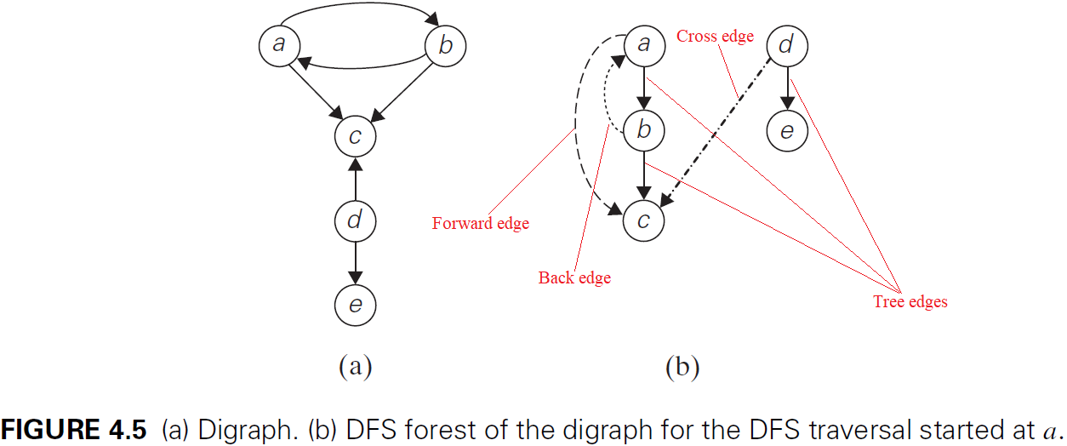
Topological Sorting
If a DFS forest of a digraph has no back edges, the digraph is a dag.
Notes:
The structure of corresponding forests in Digraph can be more complex than for undirected graphs. Consider the simple example of Figure 4.5a, the depth-first search forest (Figure 4.5b) exhibits all four types of edges possible in a DFS forest of a directed graph: tree edges (ab, bc, de), back edges (ba) from vertices to their ancestors, forward edges (ac) from vertices to their descendants in the tree other than their children, and cross edges (dc), which are none of the aforementioned types.
Note that a back edge in a DFS forest of a directed graph can connect a vertex to its parent. the presence of a back edge indicates that the digraph has a directed cycle (For example, a, b, a is a directed cycle in the digraph in Figure 4.5a.). Conversely, if a DFS forest of a digraph has no back edges, the digraph is a directed acyclic graph (dag).

Slide 11
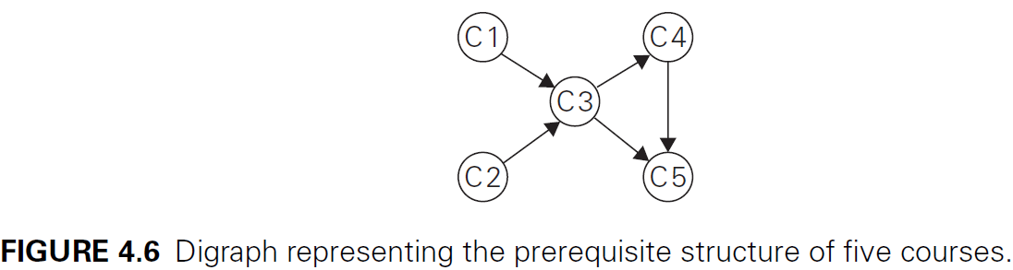
Topological Sorting
Can we list the vertices in order?
The problem has no solution if a digraph has a directed cycle
Notes:
As an example, we discuss one such question. As a motivating example, consider a set of five required courses {C1, C2, C3, C4, C5} a part-time student has to take. The courses can be taken in any order as long as the following course prerequisites are met: C1 and C2 have no prerequisites, C3 requires C1 and C2, C4 requires C3, and C5 requires C3 and C4. The student can take only one course per term. In which order should the student take the courses?
The situation can be modeled by a digraph in which vertices represent courses and directed edges indicate prerequisite requirements (Figure 4.6).
In terms of this digraph, the question is whether we can list its vertices in such an order that for every edge in the graph, the vertex where the edge starts is listed before the vertex where the edge ends. This problem is called topological sorting.
It is easy to see that the problem cannot have a solution if a digraph has a directed cycle (For example, if there is a cycle between C1 and C2, this means C1 is prerequisite of C2 and C2 is prerequisite of C1 and then there is no solution for this problem).
Thus, for topological sorting to be possible, a digraph in question must be a dag. It turns out that being a dag is not only necessary but also sufficient for topological sorting to be possible; i.e., if a digraph has no directed cycles, the topological sorting problem for it has a solution. Moreover, there are two efficient algorithms that both verify whether a digraph is a dag and, if it is, produce an ordering of vertices that solves the topological sorting problem.
There are two algorithms to solve this problem, the first is based on DFS traversal, and the second is based on decrease-(by one)-and-conquer.

Slide 12
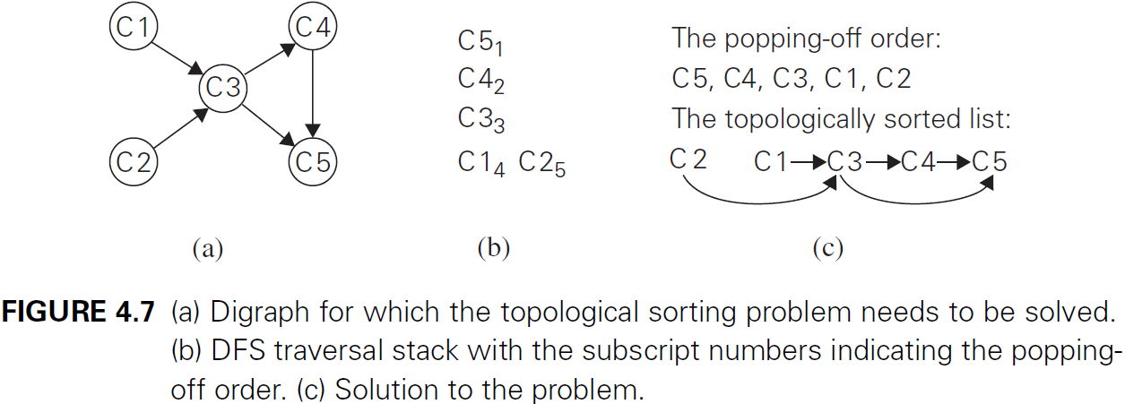
Topological Sorting
Notes:
The first algorithm performs a DFS traversal and notes the order in which vertices become dead-ends (i.e., popped off the traversal stack). Reversing this order yields a solution to the topological sorting problem, provided, of course, no back edge has been encountered during the traversal. If a back edge has been encountered, the digraph is not a dag, and topological sorting of its vertices is impossible. Why does the algorithm work? When a vertex v is popped off a DFS stack, no vertex u with an edge from u to v can be among the vertices popped off before v. (Otherwise, (u, v) would have been a back edge.) Hence, any such vertex u will be listed after v in the popped-off order list, and before v in the reversed list. Figure 4.7 illustrates an application of this algorithm to the digraph in Figure 4.6. Note that in Figure 4.7c, we have drawn the edges of the digraph, and they all point from left to right as the problem’s statement requires. It is a convenient way to check visually the correctness of a solution to an instance of the topological sorting problem.

Slide 13
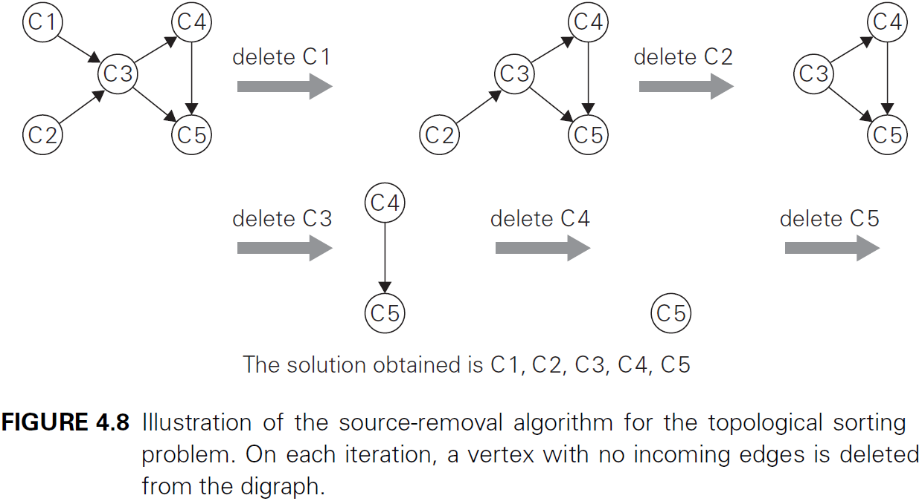
Topological Sorting
Notes:
The second algorithm repeatedly, identifies in a remaining digraph a source, which is a vertex with no incoming edges, and delete it along with all the edges outgoing from it. (If there are several sources, break the tie arbitrarily. If there are none, stop because the problem cannot be solved—see Problem 6a in this section’s exercises.) The order in which the vertices are deleted yields a solution to the topological sorting problem. The application of this algorithm to the same digraph representing the five courses is given in Figure 4.8. Note that the solution obtained by the source-removal algorithm is different from the one obtained by the DFS-based algorithm. Both of them are correct, of course; the topological sorting problem may have several alternative solutions.

Slide 14
Generating Combinatorial Objects
Combinatorial objects.
Permutations
Combinations
Subsets of a given set
Important for problems that require a consideration of different choices.
Notes:
In this section, we discuss algorithms for generating combinatorial objects.
The most important types of combinatorial objects are permutations, combinations, and subsets of a given set.
They typically arise in problems that require a consideration of different choices. We already encountered them in Chapter 3 when we discussed exhaustive search.

Slide 15
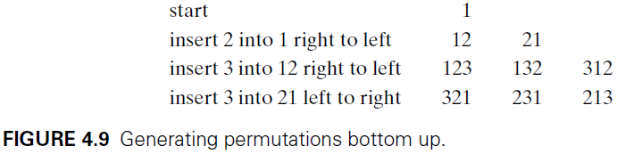
Generating Permutations
The bottom-up minimal-change algorithm.
Notes:
Let us assume that the underlying set whose elements need to be permuted is simply the set of integers from $1$ to $n$; more generally, they can be interpreted as indices of elements in an n-element set $\left\{a_{1}, …,a_{n}\right\}$. What would the decrease-by-one technique suggest for the problem of generating all n! permutations of $\{1, . . . , n\}$? The smaller-by-one problem is to generate all $(n − 1)!$ permutations. Assuming that the smaller problem is solved, we can get a solution to the larger one by inserting $n$ in each of the $n$ possible positions among elements of every permutation of $n − 1$ elements.
We can insert $n$ in the previously generated permutations either left to right or right to left. It turns out that it is beneficial to start with inserting $n$ into $12 . . . (n − 1)$ by moving right to left and then switch direction every time a new permutation of $\{1, . . . , n − 1\}$ needs to be processed. An example of applying this approach bottom up for $n = 3$ is given in Figure 4.9.
The advantage of this order of generating permutations stems from the fact that it satisfies the minimal-change requirement: each permutation can be obtained from its immediate predecessor by exchanging just two elements in it. (For the method being discussed, these two elements are always adjacent to each other.

Slide 16
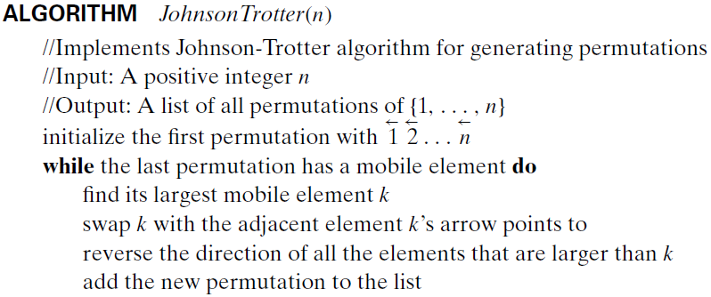

Generating Permutations
Johnson-Trotter algorithm
The time complexity of the algorithm is $θ\text{(}\text{n}\text{!)}$
Notes:
Using Johnson-Trotter algorithm, we associate a direction with each element $k$ in a permutation. We indicate such a direction by a small arrow written above the element in question, e.g., $\vec{3} \overset{⃖}{2} \vec{4} \overset{⃖}{1}$.
The element k is said to be mobile in such an arrow-marked permutation if its arrow points to a smaller number adjacent to it. For example, for the permutation $\vec{3} \overset{⃖}{2} \vec{4} \overset{⃖}{1}$, 3 and 4 are mobile while 2 and 1 are not.
Above is the Johnson-Trotter algorithm for generating permutations.
Above is an application of this algorithm for $n = 3$, with the largest mobile element shown in bold.
This algorithm is one of the most efficient for generating permutations; it can be implemented to run in time proportional to the number of permutations, i.e., in $θ\text{(}\text{n}\text{!)}$. Of course, it is horribly slow for all but very small values of $n$; however, this is not the algorithm’s “fault” but rather the fault of the problem: it simply asks to generate too many items.

Slide 17


Slide 18
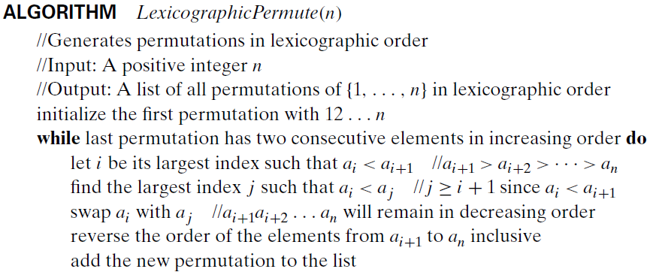

Generating Permutations
The lexicographic-order algorithm.
The permutations are listed in increasing order
Notes:
One can argue that the permutation ordering generated by the Johnson-Trotter algorithm is not quite natural; for example, the natural place for permutation $n(n − 1) . . . 1$ seems to be the last one on the list. This would be the case if permutations were listed in increasing order—also called the lexicographic order—which is the order in which they would be listed in a dictionary if the numbers were interpreted as letters of an alphabet. For example, for $n = 3$, the permutations are shown above.
So how can we generate the permutation following $a_{1}, …,a_{n}$ an in lexicographic order? If $a_{n−1} <a_{n}$, which is the case for exactly one half of all the permutations, we can simply transpose these last two elements. For example, 123 is followed by 132. If $a_{n−1}>a_{n}$, we find the permutation’s longest decreasing suffix $a_{i+1}>a_{i+2}> . . .>a_{n}$(but $a_{i}<a_{i+1}$); increase $a_{i}$ by exchanging it with the smallest element of the suffix that is greater than $a_{i}$; and reverse the new suffix to put it in increasing order. For example, 362541 is followed by 364125. Here is pseudocode of this simple algorithm whose origins go as far back as 14th-century India.

Slide 19
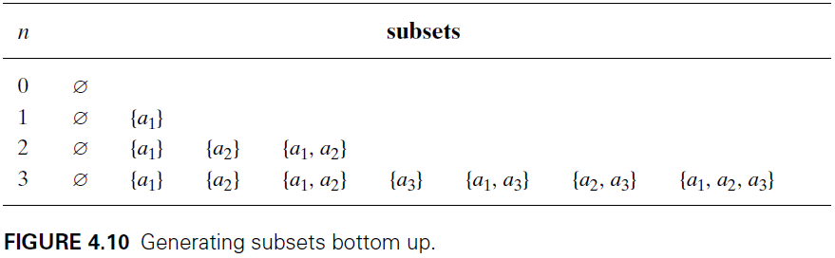
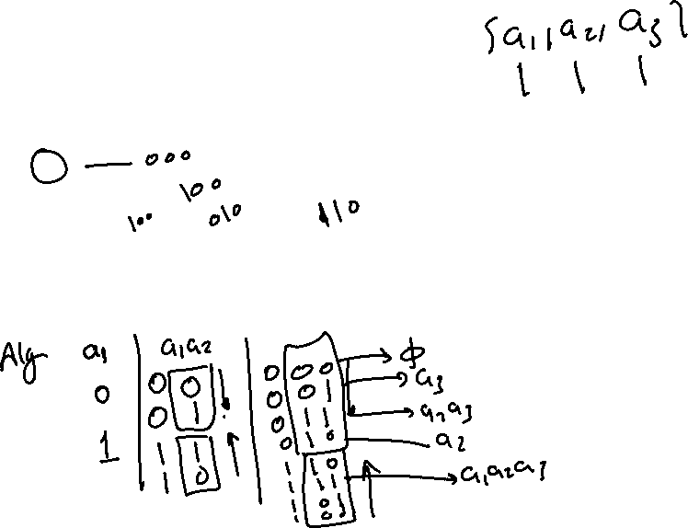
Generating Subsets
Decrease-by-one idea
Notes:
in Section 3.4 we examined the knapsack problem, which asks to find the most valuable subset of items that fits a knapsack of a given capacity. The exhaustive-search approach to solving this problem discussed there was based on generating all subsets of a given set of items. In this section, we discuss algorithms for generating all $2^{n}$ subsets of a set $A = \{a_{1}, . . . ,a_{n}\}$. (Mathematicians call the set of all subsets of a set its power set).
The decrease-by-one idea is immediately applicable to this problem, too. All subsets of $A = \{a_{1}, . . . ,a_{n}\}$ can be divided into two groups: those that do not contain $a_{n}$ and those that do. The former group is nothing but all the subsets of $\{a_{1}, . . . ,a_{n}\}$, while each and every element of the latter can be obtained by adding $a_{n}$ to a subset of $\{a_{1}, . . . ,a_{n−1}\}$. Thus, once we have a list of all subsets of $\{a_{1}, . . . ,a_{n−1}\}$, we can get all the subsets of $\{a_{1}, . . . ,a_{n}\}$ by adding to the list all its elements with $a_{n}$ put into each of them. An application of this algorithm to generate all subsets of $\{a_{1},a_{2},a_{3}\}$ is illustrated in Figure 4.10.

Slide 20
Generating Subsets
Bit string–based algorithm
Is there exists a minimal-change algorithm for generating bit strings ? Yes, the binary reflected Gray code
Notes:
Similarly to generating permutations, we do not have to generate power sets of smaller sets. A convenient way of solving the problem directly is based on a one-to-one correspondence between all $2^{n}$ subsets of an $n$ element set $A = \{a_{1}, . . . ,a_{n}\}$ and all $2^{n}$ bit strings $b_{1}, . . . ,b_{n}$ of length $n$. The easiest way to establish such a correspondence is to assign to a subset the bit string in which $b_{i}=1$ if $a_{i}$ belongs to the subset and $b_{i}=0$ if $a_{i}$ does not belong to it. For example, the bit string 110 correspond to $\{a_{1},a_{2}\}$.
With this correspondence in place, we can generate all the bit strings of length $n$ by generating successive binary numbers from $0$ to $2^{n}−1$, padded, when necessary, with an appropriate number of leading 0’s. The above figure shows the case of $n = 3$.
Is there exists a minimal-change algorithm for generating bit strings so that every one of them differs from its immediate predecessor by only a single bit? The answer to this question is yes. For example, for n = 3, we can get 000 001 011 010 110 111 101 100. Such a sequence of bit strings is called the binary reflected Gray code.

Slide 21
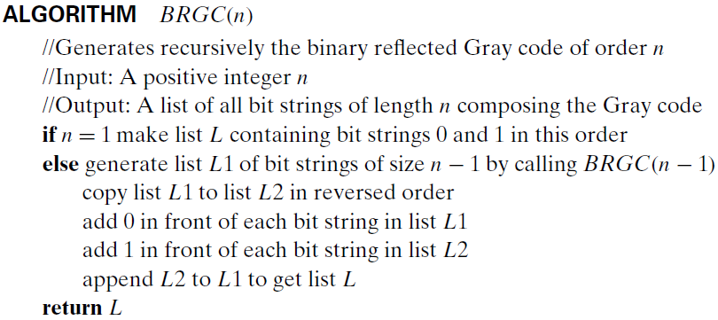
Generating Subsets
Notes:
Above is pseudocode that generates the binary reflected Gray code recursively.

Slide 22
Decrease-by-a-Constant-Factor Algorithms
The exponentiation problem.
Binary search.
Fake-Coin Problem
Russian Peasant Multiplication
Josephus Problem
Notes:
One example of algorithms based on this technique and mentioned earlier is the exponentiation by squaring defined by formula (4.2). In this section, you will find a few other examples of such algorithms. The most important and well-known of them is binary search. Other examples are Fake-Coin Problem, Russian Peasant Multiplication, and Josephus Problem.

Slide 23
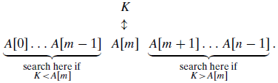
Binary Search
Efficient for searching a sorted array.
Example: search for 70.
Notes:
Binary search is a remarkably efficient algorithm for searching in a sorted array. It works by comparing a search key $K$ with the array’s middle element $A[m]$. If they match, the algorithm stops; otherwise, the same operation is repeated recursively for the first half of the array if $K <A[m]$, and for the second half if $K >A[m]$.
As an example, let us apply binary search to searching for K = 70 in the above array.

Slide 24
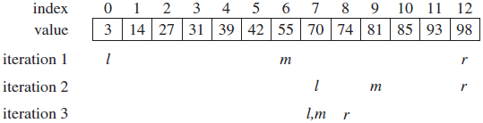
Binary Search
Notes:
The iterations of the algorithm are shown above.

Slide 25
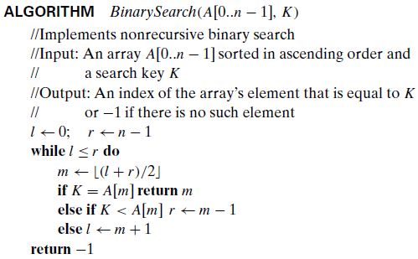
Binary Search
Notes:
The binary search is clearly based on a recursive idea, it can be easily implemented as a nonrecursive algorithm, too. Here is pseudocode of this nonrecursive version.

Slide 26
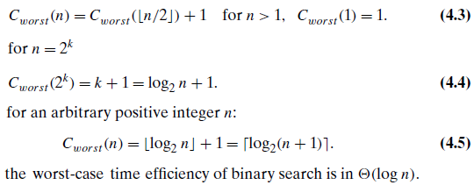
Binary Search
Notes:
To analyze the efficiency of binary search, we count the number of times the search key is compared with an element of the array. For the sake of simplicity, we will count the so-called three-way comparisons. This assumes that after one comparison of K with A[m], the algorithm can determine whether K is smaller, equal to, or larger than A[m].
In the worst case, inputs include all arrays that do not contain a given search key, as well as some successful searches (when the key is found in the last possible iteration). Since after one comparison the algorithm faces the same situation but for an array half the size, we get the following recurrence relation for $C_{worst} (n)$: $C_{worst} \left(n\right)=C_{worst} \left(\left\lfloor \frac{n}{2}\right\rfloor \right)+1$ for $n>1$, $C_{worst}\left(1\right)=1$.
We already encountered recurrence (4.3), with a different initial condition (see recurrence (2.4) and its solution there for n = 2k). For the initial condition We already encountered recurrence (4.3), with a different initial condition, in Section 2.4 (see recurrence (2.4) and its solution there for $n=2^{k}$). For the initial condition $C_{worst}\left(1\right)=1$, we obtain $C_{worst}\left(2^{k}\right)=k+1=\log_{2}n+1$.
The above solution can be tweaked to get a solution valid for an arbitrary positive integer $n$: $C_{worst} \left(n\right)=\left\lfloor \log_{2}n\right\rfloor +1 ∈ θ(\log{n})$

Slide 27
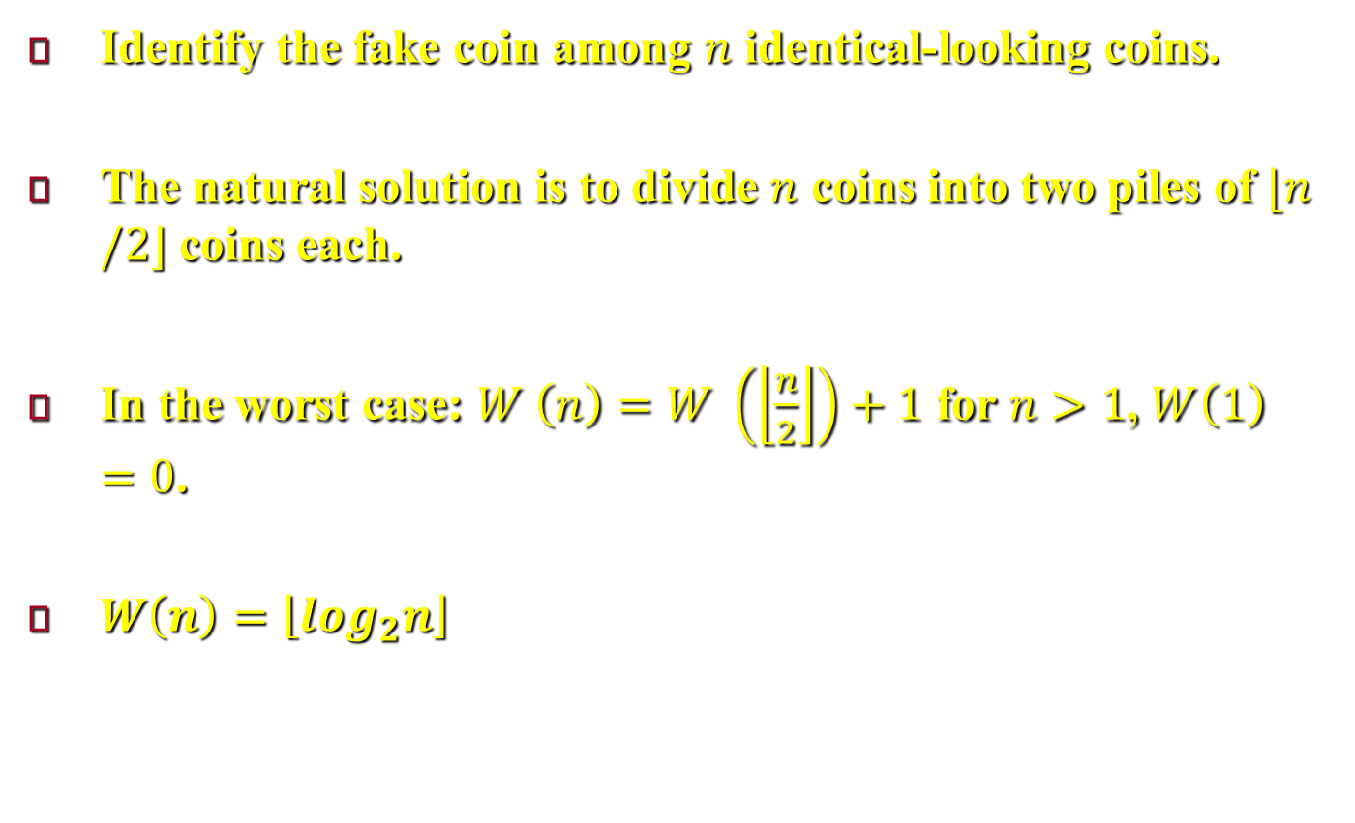
Fake-Coin Problem
Identify the fake coin among $n$ identical-looking coins.
The natural solution is to divide $n$ coins into two piles of $⌊n/2⌋$ coins each.
In the worst case: $W \left(n\right)=W \left(\left\lfloor \frac{n}{2}\right\rfloor \right)+1$ for $n>1$, $W\left(1\right)=0$.
$W\left(n\right)=\left\lfloor \log_{2}n\right\rfloor$
Notes:
Among $n$ identical-looking coins, one is fake. With a balance scale, we can compare any two sets of coins. That is, by tipping to the left, to the right, or staying even, the balance scale will tell whether the sets weigh the same or which of the sets is heavier than the other but not by how much.
The problem is to design an efficient algorithm for detecting the fake coin. An easier version of the problem—the one we discuss here—assumes that the fake coin is known to be, say, lighter than the genuine one.
The most natural idea for solving this problem is to divide n coins into two piles of $\left\lfloor \frac{n}{2}\right\rfloor$ coins each, leaving one extra coin aside if $n$ is odd, and put the two piles on the scale. If the piles weigh the same, the coin put aside must be fake; otherwise, we can proceed in the same manner with the lighter pile, which must include the fake coin.
We can set up a recurrence relation for the number of weighings $W(n)$ needed by this algorithm in the worst case: $W \left(n\right)=W \left(\left\lfloor \frac{n}{2}\right\rfloor \right)+1$ for $n>1$, $W\left(1\right)=0$. it is almost identical to the binary search. (The difference is in the initial condition). Then $W\left(n\right)=\left\lfloor \log_{2}n\right\rfloor$.

Slide 28
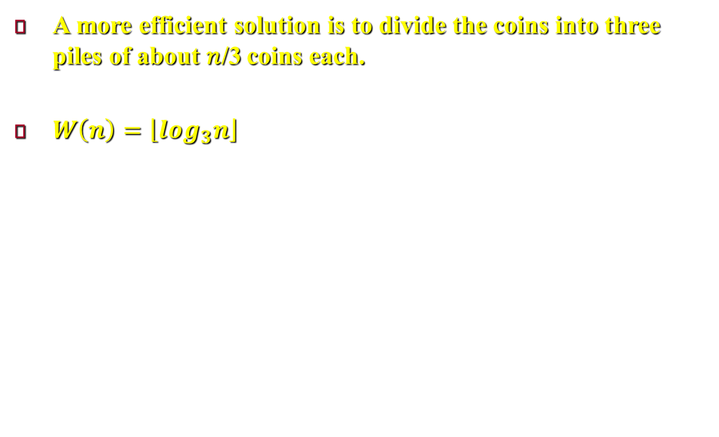
Fake-Coin Problem
A more efficient solution is to divide the coins into three piles of about 𝑛/3 coins each.
$W\left(n\right)=\left\lfloor \log_{3}n\right\rfloor$
Notes:
The interesting point here is the fact that the above algorithm is not the most efficient solution. It would be more efficient to divide the coins not into two but into three piles of about $n/3$ coins each. After weighing two of the piles, we can reduce the instance size by a factor of three. Accordingly, we should expect the number of weighings to be about $\log_{3}n$, which is smaller than $\log_{2}n$.

Slide 29
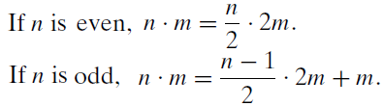
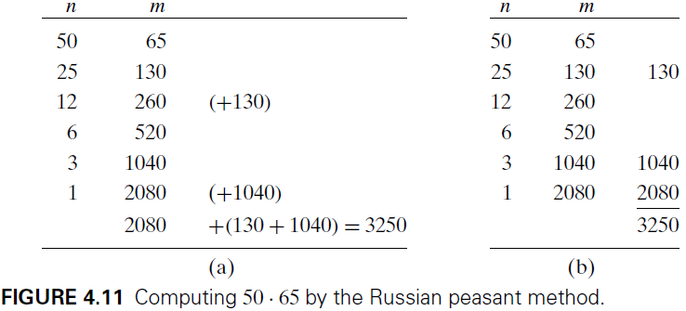
Russian Peasant Multiplication
Computing $n.m$ recursively or iteratively.
leads to very fast hardware implementation
Notes:
Let $n$ and $m$ be positive integers whose product we want to compute, and let us measure the instance size by the value of $n$. if $n$ is even, an instance of half the size has to deal with $n/2$, and we have an obvious formula relating the solution to the problem’s larger instance to the solution to the smaller one: $n.m=\frac{n}{m}.2m$. If $n$ is odd, we need only a slight adjustment of this formula: $n.m=\frac{n−1}{m}.2m+m$.
Using these formulas and the trivial case of $1 . m = m$ to stop, we can compute product $n . m$ either recursively or iteratively. An example of computing $50 . 65$ with this algorithm is given in Figure 4.11. Note that all the extra addends shown in parentheses in Figure 4.11a are in the rows that have odd values in the first column. Therefore, we can find the product by simply adding all the elements in the $m$ column that have an odd number in the $n$ column (Figure 4.11b). Also note that the algorithm involves just the simple operations of halving, doubling, and adding.
This leads to very fast hardware implementation since doubling and halving of binary numbers can be performed using shifts, which are among the most basic operations at the machine level.

Slide 30
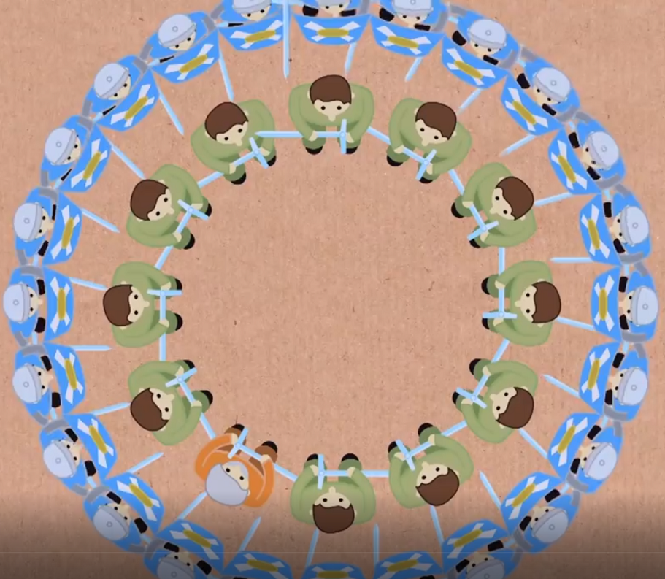
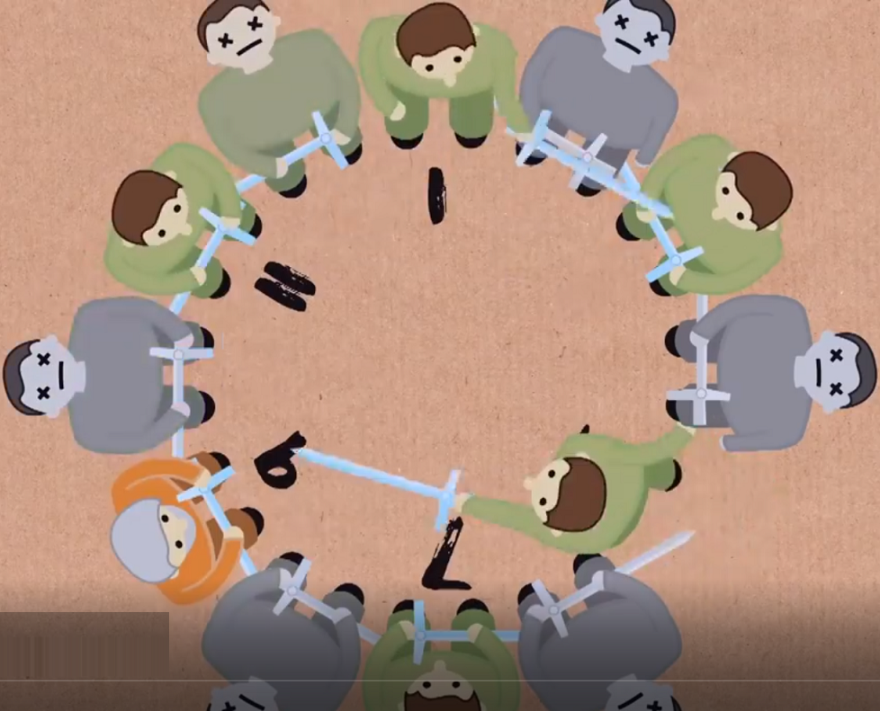
Josephus Problem
Notes:
The Josephus problem dates back to BC, when Flavius Josephus, along with other rebels, started a fight against the Romans, and when the Romans won, the Josephus came to a cave with forty rebels who voted not to surrender to the Romans, and then the Josephus suggested that a lottery be held whereby each individual kills whose next to him, and when there were two surviving men (Josephus and another one), Josephus persuaded the other to surrender.

Slide 31
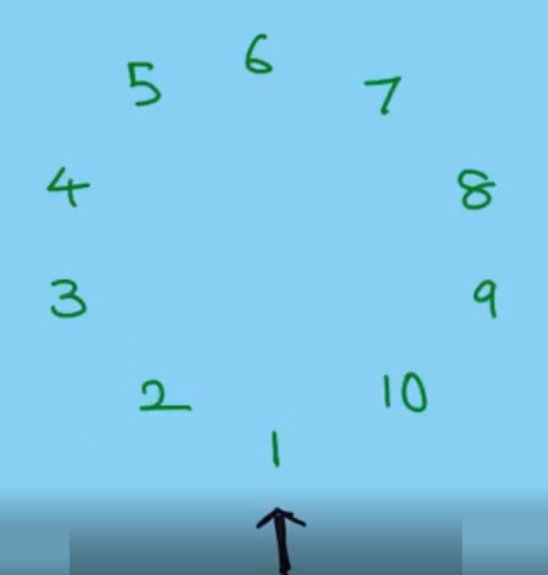
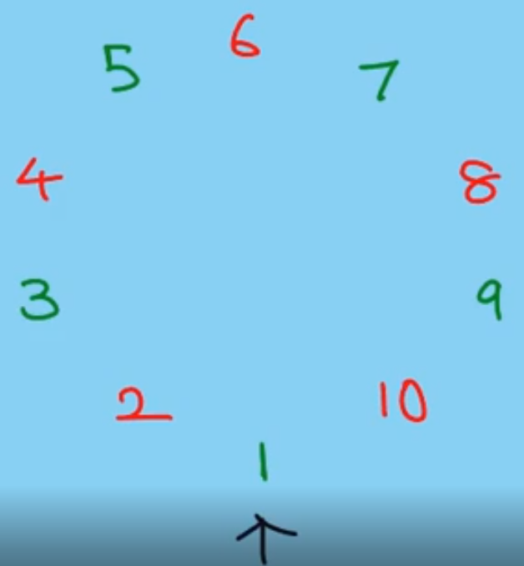
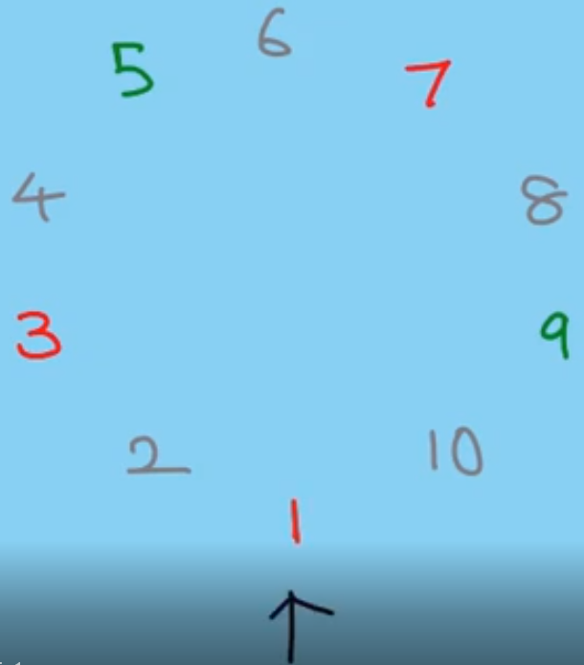
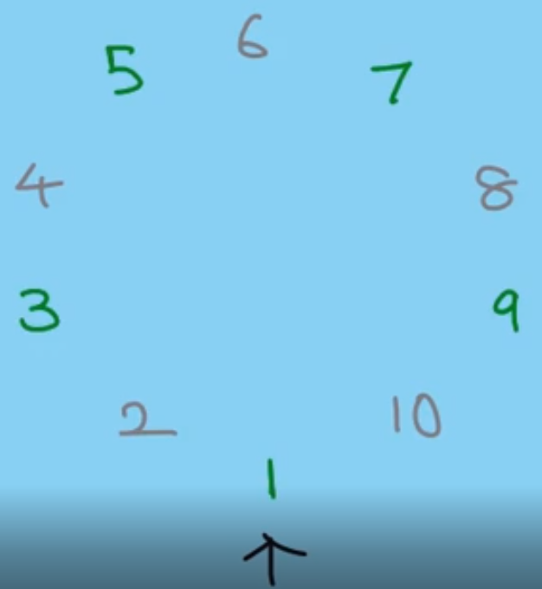
Josephus Problem
Notes:
let $n$ people numbered $1$ to $n$ stand in a circle. Starting the count with person number 1, we eliminate every second person until only one survivor is left. The problem is to determine the survivor’s number $J(n)$.
For example, if we have numbers from $1$ to $10$, so starting from $1$, we remove the numbers in clockwise skipping exactly one number. i.e., we remove 2, 4, 6, 8, 10. The removed numbers are excluded from the circle. Then the same process is continued with the remaining numbers.

Slide 32
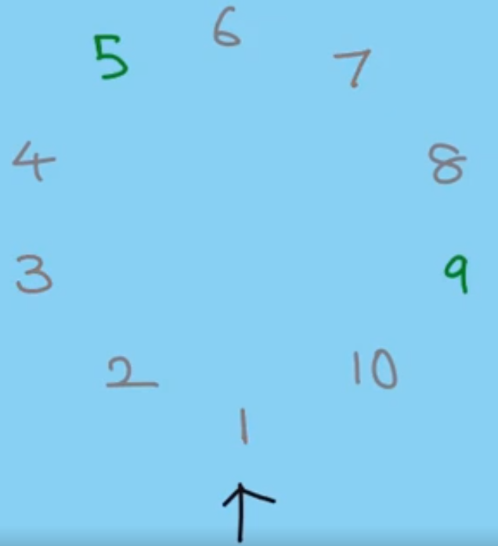
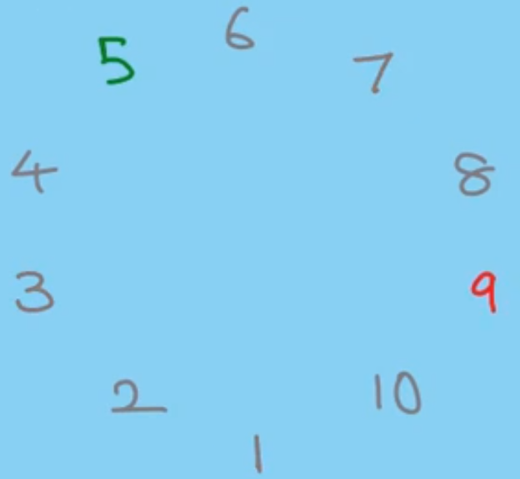
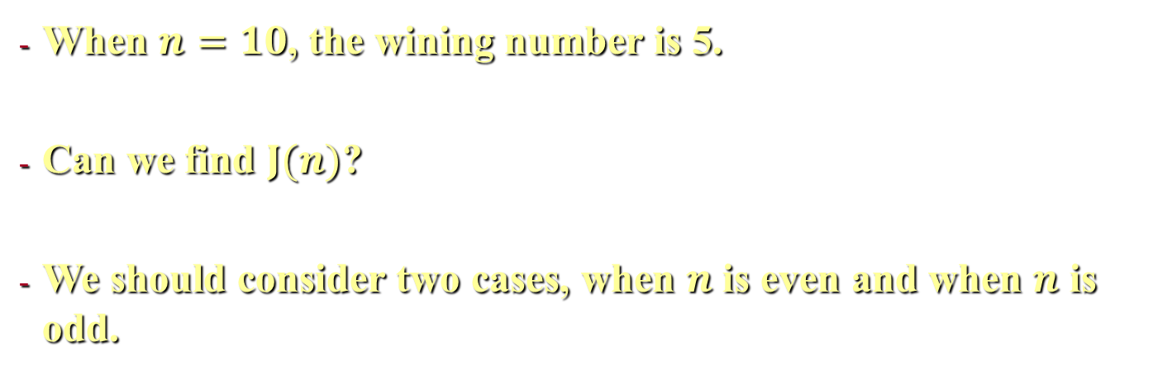
Josephus Problem
When $n=10$, the wining number is 5.
Can we find $J(n)$?
We should consider two cases, when $n$ is even and when $n$ is odd.
Notes:
We continue the process until one number remains. So the final (wining) number remaining is 5.
This was the case when $n=10$. can we find the wining number for any $n$, $J(n)$? This is Josephus Problem. To answer this question, we consider two cases, when $n=2k$ is even and when $n=2k+1$ is odd.
Note that, the function $J$ gets the initial position of the wining number which is the same as the wining number because the first sequence starts from $1$ up to $2k$.

Slide 33
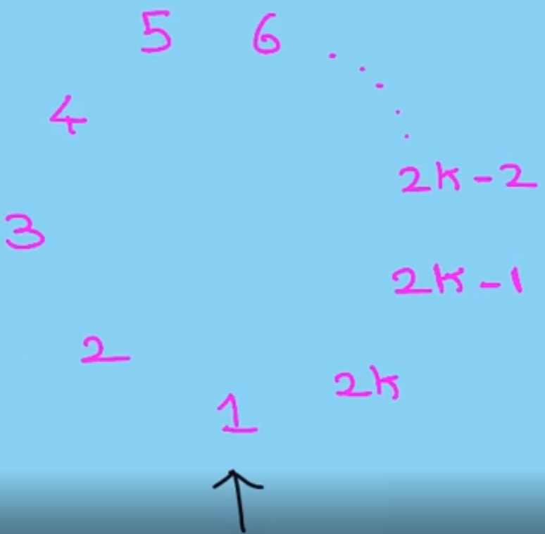
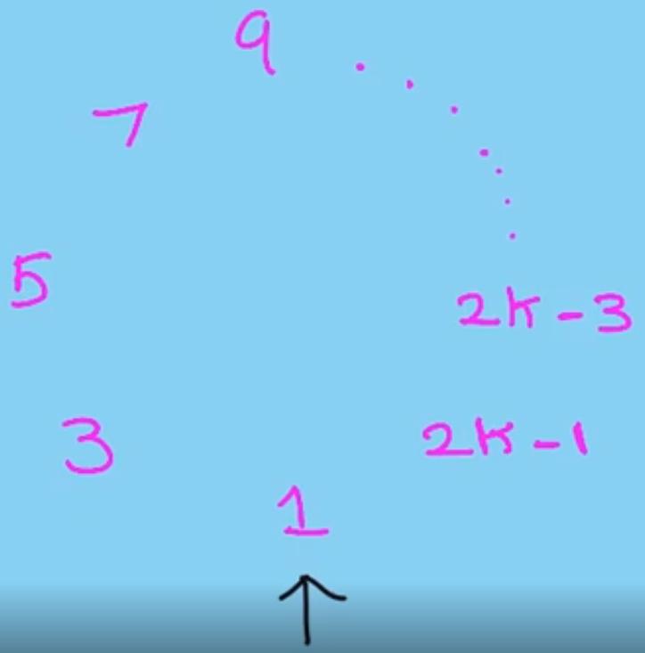
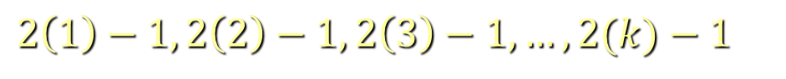
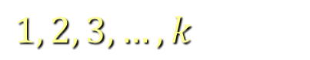
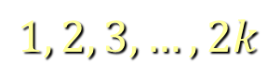
Josephus Problem
$$1, 2, 3, …, 2k$$
$$1, 2, 3, …, k$$
$$2\left(1\right)−1, 2\left(2\right)−1, 2\left(3\right)−1, …, 2(k)−1$$
Notes:
When $n=2k$ is even, we have the sequence $1, 2, 3, …, 2k$, where $1$ holds position $1$, and $2$ holds position $2$, and $2k$ holds position $2k$. Now, when the even numbers are removed, there will be $k$ odd numbers remaining.
The remaining $k$ odd numbers are $1, 3, 5, …, 2k−1$, where $1$ holds position $1$, and $3$ holds position $2$, and $2k−1$ holds position $k$. Note that, there is a relation between the initial sequence positions and the current sequence positions (for example, $1$ holds position $(1)$ in the current sequence, and position $(1=2×1−1)$ in the initial sequence, similarly, $3$ holds position $(2)$ in the current sequence, and position $(3=2×2−1)$ in the initial sequence, and $2k−1$ holds position $(k)$ in the current sequence, and position $(2k−1=2×k−1)$ in the initial sequence). Therefore, if the final number in the current sequence holds position $k$, this number was holding position $2k−1$ in the previous sequence.
Since the last sequence has only one number (the wining number) that holds position $1$ (the only remaining position, i.e. $J\left(1\right)=1$), therefore we can get the original position of this number using this recurrence $J\left(2k\right)=2J\left(k\right)−1$. Recall that, the function $J$ gets the initial position of the wining number which is the same as the wining number because the first sequence starts from $1$ up to $2k$.

Slide 34
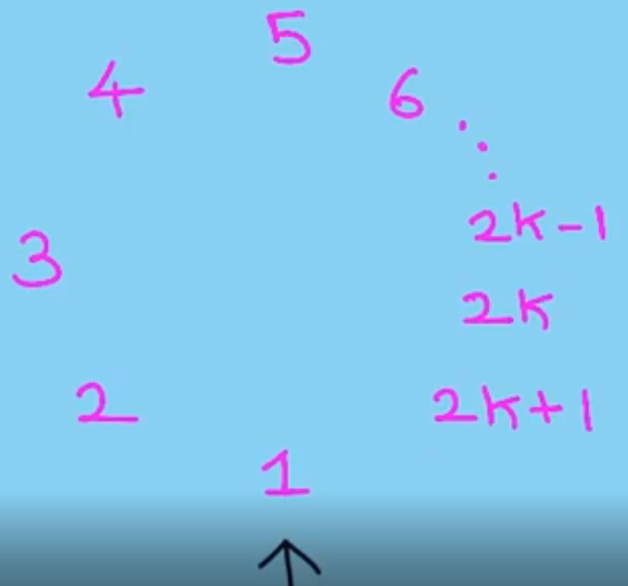
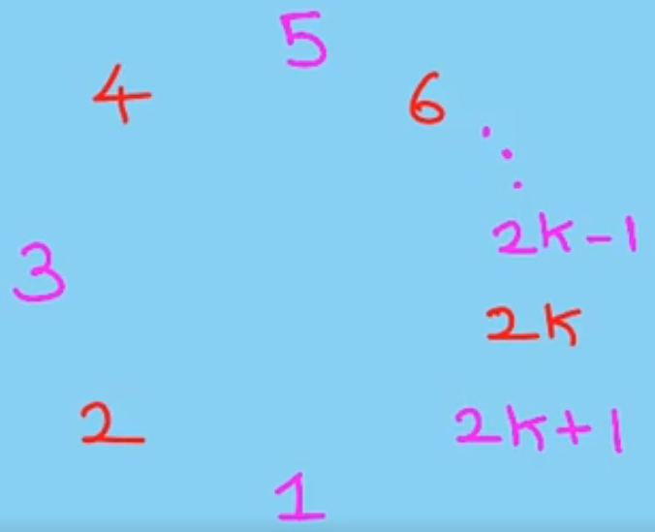
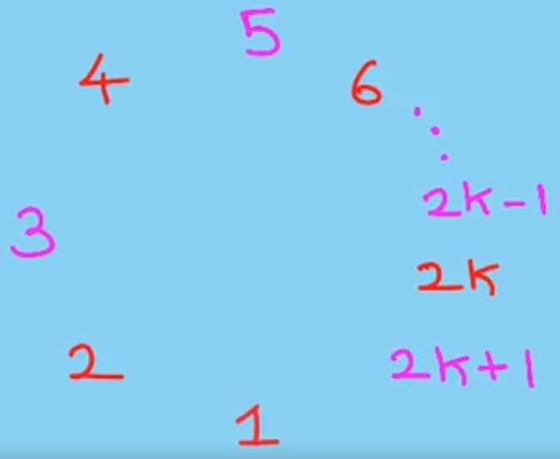
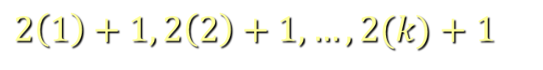
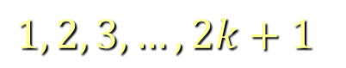
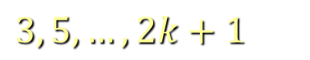
Josephus Problem
$$1, 2, 3, …, 2k+1$$
$$3, 5, …, 2k+1$$
$$2\left(1\right)+1, 2\left(2\right)+1, …, 2(k)+1$$
Notes:
Now, let us consider when $n$ is odd. The even numbers will be removed. After that number $1$ will removed. Therefore, the remaining $k$ numbers are $3, 5, …, 2k+1$, in positions $1, 2, …, k$. These numbers were in positions $(3=2×1+1)$, $\left(5=2×2+1\right), …,(2k+1=2×k+1)$.
Similar to the even case, the recurrence in the odd case can be written as $J\left(2k\right)=2J\left(k\right)+1$. Note that when the sequence contains only two numbers it is clear that the wining number is the number that holds position $1$, i.e., $J\left(2\right)=1$

Slide 35
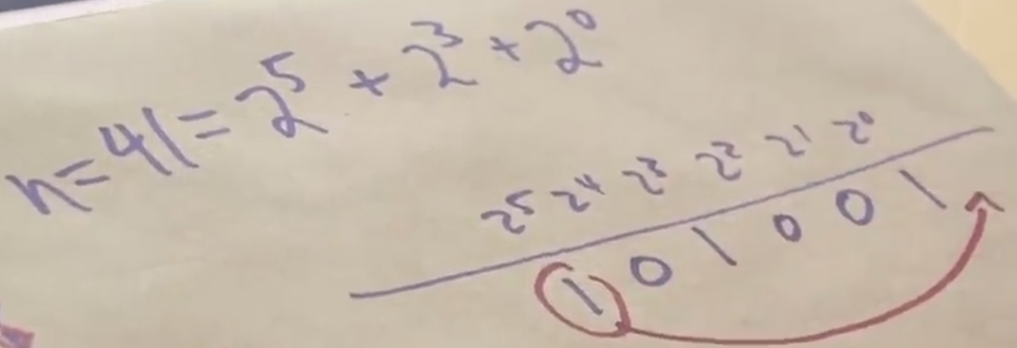
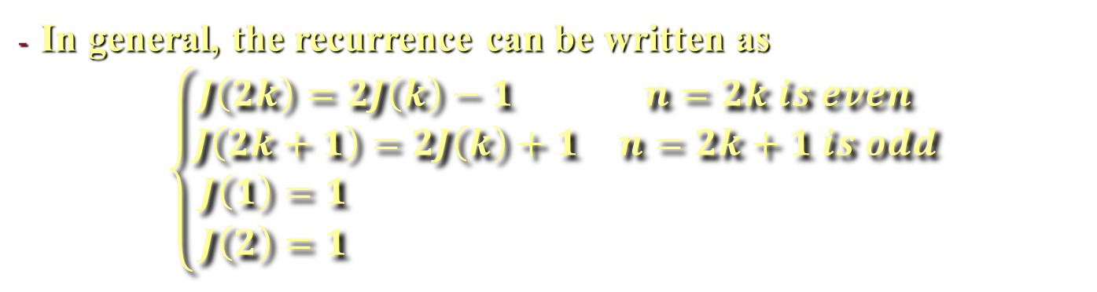
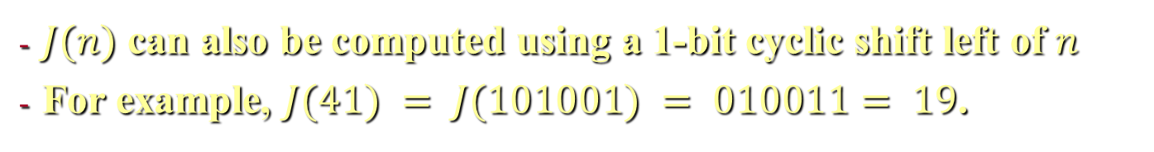
Josephus Problem
In general, the recurrence can be written as
$$\left\{\begin{matrix}\begin{matrix}J\left(2k\right)=2J\left(k\right)−1 & n=2k is even \\ J\left(2k+1\right)=2J\left(k\right)+1 & n=2k+1 is odd\end{matrix} \\ \begin{matrix}J\left(1\right)=1 & \\ J\left(2\right)=1 & \end{matrix}\end{matrix}\right.$$
$J(n)$ can also be computed using a 1-bit cyclic shift left of $n$
For example, $J(41) = J(101001) = 010011= 19$.
Notes:
- There is an elegant form to compute $J(n)$ in binary notation. It can be obtained by a 1-bit cyclic shift left of $n$ itself! For example, $J(41) = J(101001) = 010011= 19$.

Slide 36
Variable-Size-Decrease Algorithms
Euclid’s algorithm for computing the GCD
Selection problem
Searching in a Binary Search Tree
Notes:
In this case, the size reduction pattern varies from one iteration of the algorithm to another. Euclid’s algorithm for computing the greatest common divisor is a good example. Here, we encounter a few more examples of this variety.

Slide 37

Selection problem
Find the $kth$ smallest element in a list of 𝑛 numbers.
A special case is finding the median where $k=⎾n/2⏋$.
One way to do so is sorting the list then selecting the 𝑘𝑡ℎ element. In the best case, the algorithm’s efficiency is in $O(n log⁡n)$.
Notes:
The selection problem is the problem of finding the $kth$ smallest element in a list of $n$ numbers. This number is called the $kth$ order statistic. Of course, for $k = 1$ or $k = n$, we can simply scan the list in question to find the smallest or largest element, respectively.
A more interesting case of this problem is finding the median (the middle element in a list which is larger than one half of the list’s elements and smaller than the other half). In this case $k=⎾n/2⏋$.
Obviously, we can find the $kth$ smallest element in a list by sorting the list first and then selecting the $kth$ element in the output of a sorting algorithm. The time of such an algorithm is determined by the efficiency of the sorting algorithm used. Thus, with a fast sorting algorithm such as merge sort (discussed in the next chapter), the algorithm’s efficiency is in $O(n log⁡n)$.

Slide 38

Selection problem
Another way is to take advantage of the idea of partitioning.
Lomuto partitioning
Notes:
Another way is to take advantage of the idea of partitioning a given list around some value $p$ (for example, the first element in the list). In this case we have three parts, the left part contains all the elements smaller than or equal to $p$, followed by the pivot $p$ itself, followed by all the elements greater than or equal to $p$, as shown above.
Here we use the Lomuto partitioning. The input to this algorithm is an array of $n$ elements — or, more generally, a subarray $A[l..r]$ where $(0 ≤ l ≤ r ≤ n − 1)$. The algorithm scans the subarray $A[l..r]$ left to right, in iterations. On each iteration, it compares the first element in the unknown segment (pointed to by the index $i$ in Figure 4.13a) with the pivot $p$. If $A[i]≥ p$, $i$ is incremented by one. If $A[i]<p$, $s$ is incremented by one, $A[i]$ and $A[s]$ are swapped, and then $i$ is incremented by one. After no unprocessed elements remain (Figure 4.13b), the algorithm swaps the pivot with $A[s]$ to achieve a partition being sought (Figure 4.13c).

Slide 39

Selection problem
Notes:
Above is the pseudocode implementing this partitioning procedure.

Slide 40

Selection problem
Notes:
How can we take advantage of a list partition to find the $kth$ smallest element in it? Let us assume that the list is implemented as an array whose elements are indexed starting with a $0$, and let $s$ be the partition’s split position, i.e., the index of the array’s element occupied by the pivot after partitioning. If $s = k − 1$, pivot $p$ itself is obviously the $kth$ smallest element, which solves the problem. If $s > k − 1$, the $kth$ smallest element in the entire array can be found as the $kth$ smallest element in the left part of the partitioned array. And if $s < k − 1$, it can be found as the $(k − s)th$ smallest element in its right part. Thus, if we do not solve the problem outright, we reduce its instance to a smaller one, which can be solved by the same approach, i.e., recursively. This algorithm is called quickselect.
Above, is the quickselect algorithm.

Slide 41

Selection problem
EXAMPLE. Find the median of the following numbers: 4, 1, 10, 8, 7, 12, 9, 2, 15.
Notes:
EXAMPLE Apply the partition-based algorithm to find the median of the following list of nine numbers: 4, 1, 10, 8, 7, 12, 9, 2, 15. Here, $k=⎾\frac{9}{2}⏋=5$ and our task is to find the $5th$ smallest element in the array.
Above, we show the pivots in bold.

Slide 42

Selection problem
$s≤k − 1$, then proceed with the right part of the array
$s=k − 1$, then stop. The median is 8
Notes:
Since $s = 2$ is smaller than $k − 1= 4$, we proceed with the right part of the array. Now s = k − 1= 4, and hence we can stop: the found median is 8, which is greater than 2, 1, 4, and 7 but smaller than 12, 9, 10, and 15.

Slide 43

Selection problem
How efficient is quickselect?
$C_{best} (n) = n − 1 ∈θ(n)$
$C_{worst}(n)=(n − 1) + (n − 2) + . . . + 1= (n − 1)n/2 ∈θ(n^{2})$
Notes:
How efficient is quickselect? Partitioning an $n$-element array always requires $n − 1$ key comparisons. If it produces the split that solves the selection problem without requiring more iterations, then for this best case we obtain $C_{best} (n) = n − 1 ∈θ(n)$. Unfortunately, the algorithm can produce an extremely unbalanced partition of a given array, with one part being empty and the other containing $n − 1$ elements. In the worst case, this can happen on each of the $n − 1$ iterations. (For a specific example of the worst-case input, consider, the case of $k = n$ and a strictly increasing array). This implies that $C_{worst}(n)=(n − 1) + (n − 2) + . . . + 1= (n − 1)n/2 ∈θ(n^{2})$.

Slide 44
Searching in a Binary Search Tree
Algorithm BST(x, v)
//Searches for node with key equal to v in BST rooted at node x
if x = NIL return -1
else if v = K(x) return x
else if v < K(x) return BST(left(x), v)
else return BST(right(x), v)
Notes:
When we need to search for an element of a given value $v$ in such a binary search tree, we do it recursively in the following manner. If the tree is empty, the search ends in failure. If the tree is not empty, we compare $v$ with the tree’s root $K(r)$. If they match, a desired element is found and the search is stopped; if they do not match, we continue with the search in the left subtree of the root if $v < K(r)$ and in the right subtree if $v > K(r)$. Thus, on each iteration of the algorithm, the problem of searching in a binary search tree is reduced to searching in a smaller binary search tree. The most sensible measure of the size of a search tree is its height; obviously, the decrease in a tree’s height normally changes from one iteration to another of the binary tree search—thus giving us an excellent example of a variable-size-decrease algorithm.

Slide 45


Searching in a Binary Search Tree
Efficiency
Worst case: C(n) in $θ(n)$
Average case: C(n) in $θ\text{(}\text{log} \text{n}\text{)}$
Notes:
In the worst case of the binary tree search, the tree is severely skewed. This happens, in particular, if a tree is constructed by successive insertions of an increasing or decreasing sequence of keys (Figure 4.15). The search for $a_{n−1}$ in such a tree requires $n$ comparisons, making the worst-case efficiency of the search operation fall into $θ(n)$. Fortunately, the average-case efficiency turns out to be in $θ\text{(}\text{log} \text{n}\text{)}$.

